Slide 1
Mobile GPUs
Varun Sampath
University of Pennsylvania
CIS 565 - Spring 2012

Slide 2
Agenda
SoCs
Case Studies
NVIDIA Tegra 2, Tegra 3
Imagination Technologies’ PowerVR SGX Series5XT
Apple iPad (2012)
Future
Note about sources

Slide 3
What is an SoC?
System-on-a-Chip
CPU, GPU, DSP, I/O
Single-chip solution
Top mobile SoC vendors:
Qualcomm, Apple, TI, Samsung, NVIDIA
Advantages of using SoCs?
Disadvantages?
We will see all consumer chips converge to SoCs
Market Share Data from PC Perspective
Notes:
Advantages:
Much lower energy (less off-chip interconnect)
Easier to build and mass-produce
Area savings
Disadvantages
Less flexibility with vendors
Stuck with components you may not need (IGPs for example)
Haswell will bring the I/O controller on-chip

Slide 4
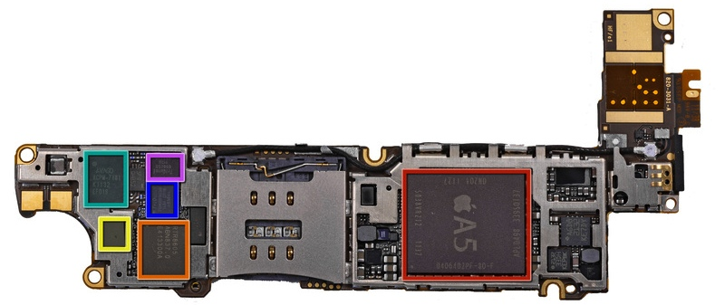
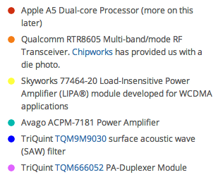
What is an SoC?
Image from iFixit
Notes:
A5 has CPU, GPU, flash controller, even RAM in PoP design

Slide 5
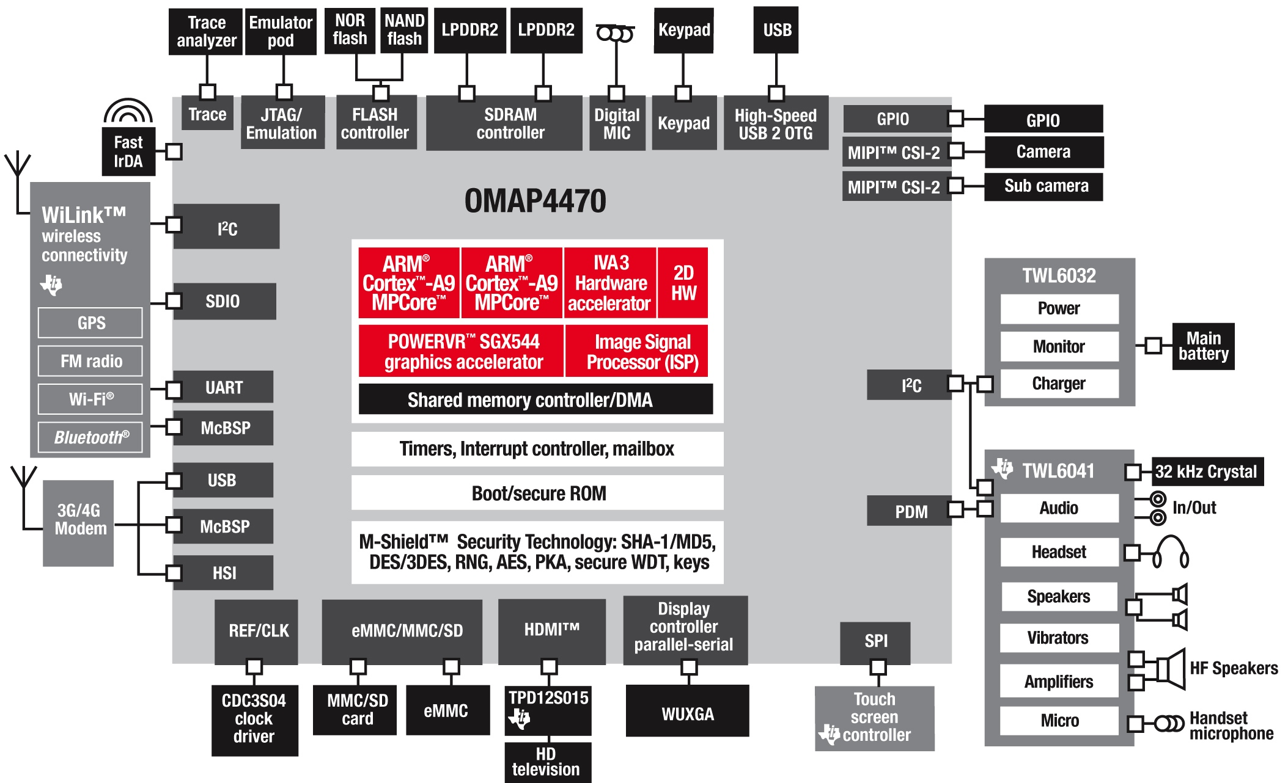
Block Diagram of TI OMAP 4470
Image from TI

Slide 6
Brief Discussion of ARM
RISC CPU vendor that currently dominates mobile
Mobile Designs: Cortex-A8, A9, A15
Fabless Designer
Core Design Licensees
Architecture Licensees
Qualcomm Scorpion/Krait
NVIDIA

Slide 7
The Constraints of Mobile
Energy
Cell phone battery capacity of 5-7 Wh (tablets 20-40 Wh)
How much energy can our chips consume?
Area
PCB size constraints
Cooling constraints
Notes:
Must consider displays, radios. What are the dominant sources of battery drain?

Slide 8
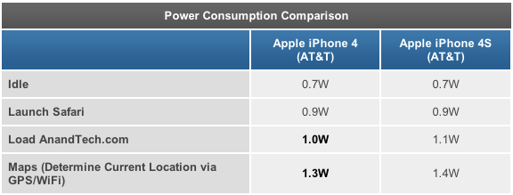
Some Energy Numbers
Data from AnandTech

Slide 9
Some Contributors to Switching Energy
Off-chip Interconnect (to DRAM)
Bandwidth is expensive
Minimize reasons to fire up memory bus
High frequencies
Requires increased voltages

Slide 10
Some Theoretical Performance Numbers
 | Apple iPad 2 | ASUS Transformer Prime | Some Nice Desktop
CPU | A5 @ 1GHz | Tegra 3 @ 1.4GHz | Sandy Bridge @ 3.4GHz
GPU | POWERVR SGX543MP2 @ 250MHz | Mobile GeForce @ 500MHz | GTX680 @ 1GHz
Memory Interface | 64-bit @ (maybe) 800MHz = 6.4GB/s | 32-bit | 256-bit @ 6GHz = 192GB/s
GPU GFLOPS | 16 GFLOPS | 12 GFLOPS | 3 TFLOPS
Mobile Data from AnandTech
GTX680 Specs from Newegg

Slide 11
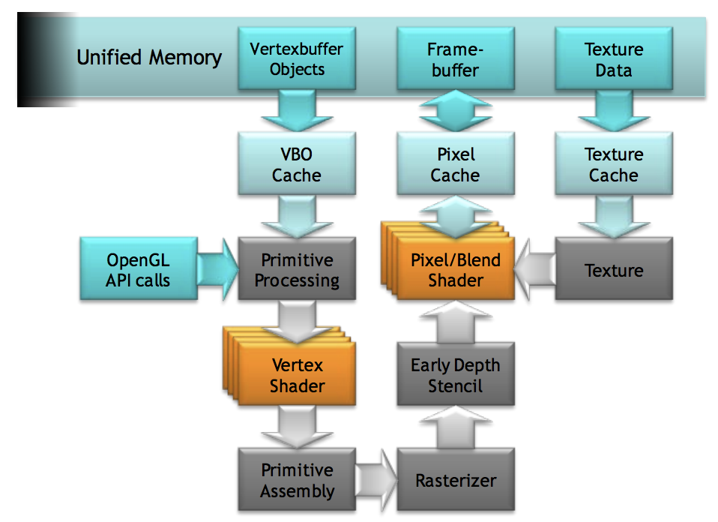
GeForce GPU in NVIDIA Tegra 2
Image from NVIDIA
Notes:
Note that mobile GeForce is a typical immediate mode renderer with early-z rejection.

Slide 12
Tegra 2 Mobile GeForce
Separate vertex and pixel shaders
4 of each, each capable of 1 multiply-add /clock
Pixel, texture, vertex, and attribute caches
Reduce memory transactions
Pixel cache useful for UI components
Memory controller optimizations
Arbitrate between CPU & GPU requests
Reorder requests to limit bank switching

Slide 13
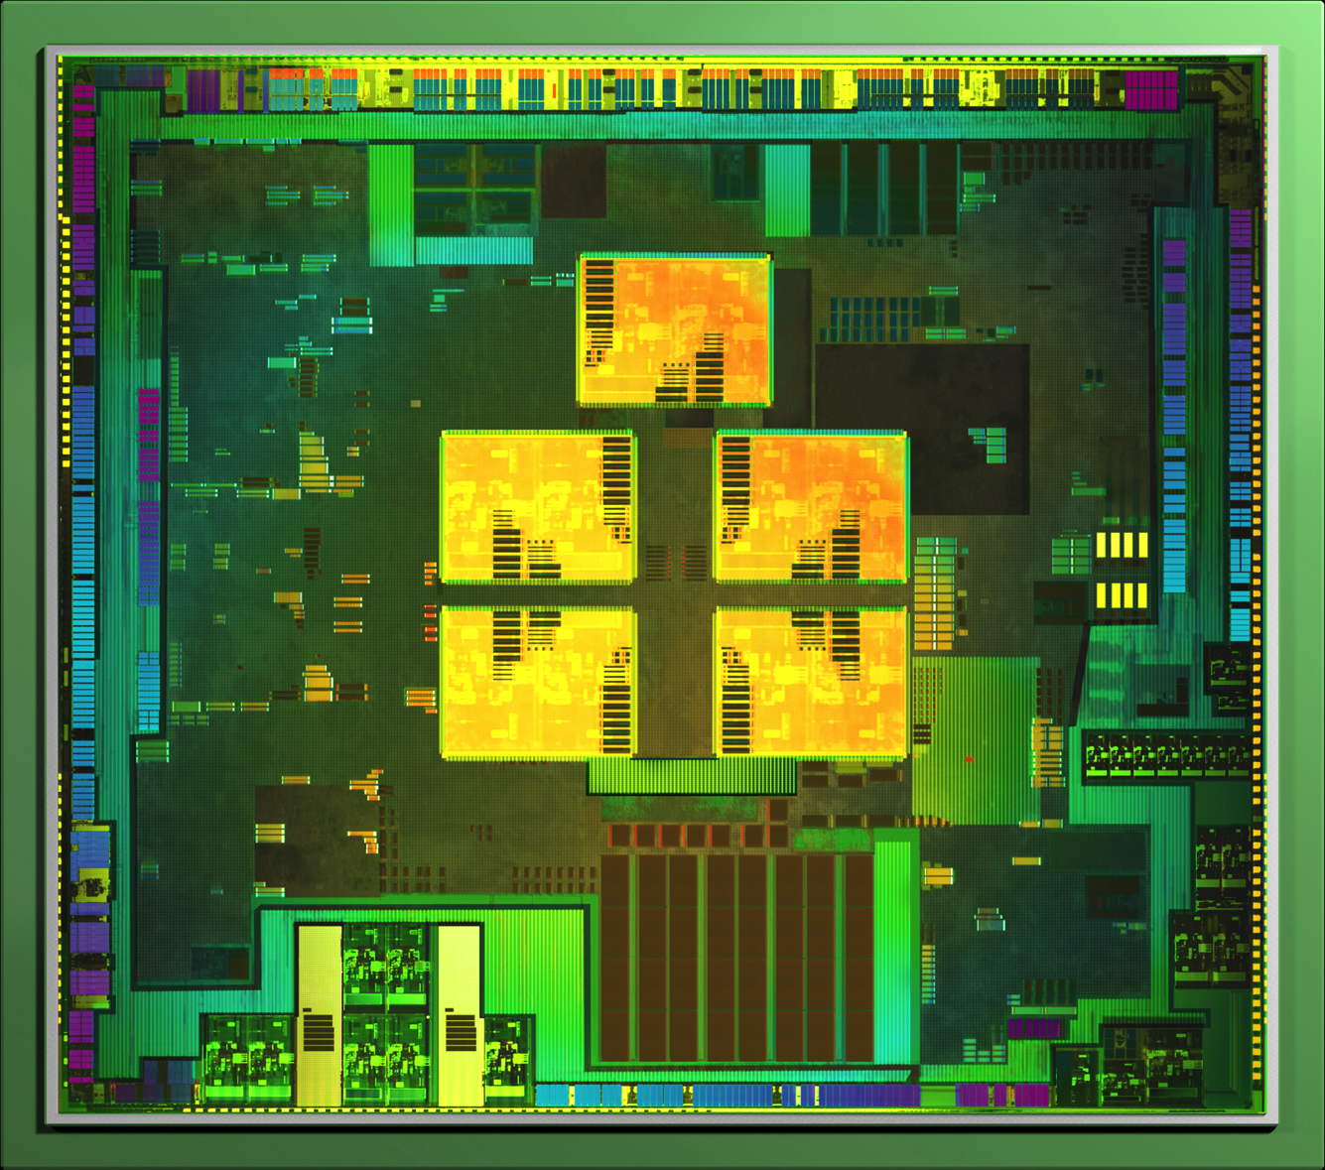
NVIDIA Tegra 3 (Kal-El)
Expanded Mobile GeForce
4 vertex and 8 pixel shaders
4-PLUS-1 architecture
Image from AnandTech
Notes:
Tegra 3 also has higher clocks for the GPU

Slide 14
PowerVR SGX
TA (Tile Accelerator) – store scene data and split up screen into tiles
ISP (Image Synthesis Processor) – perform Hidden Surface Removal with z-testing
TSP (Texture and Shading Processor) – run pixel shader
Image from ImgTec

Slide 15
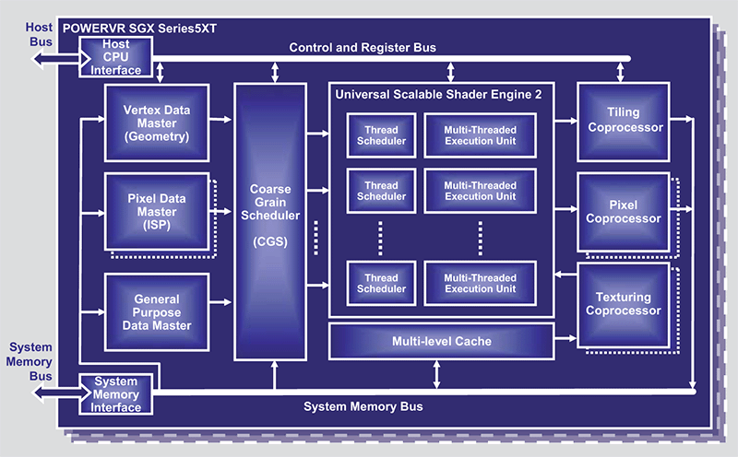
PowerVR SGX Series5XT
Image from ImgTec
Notes:
USSE2 unified shaders perform vertex and pixel shading. Multi-threaded execution units are 4-wide vector processors

Slide 16
Summarizing PowerVR SGX Series5XT
Used in Apple A5, A5X
Unified shader architecture (called USSE2)
Tile based deferred rendering (TBDR)
Will cover in more detail next week
Multi-core architecture

Slide 17
Mobile GPU Families
Qualcomm Adreno
Unified shaders, 4-wide SIMD
immediate mode with early-z
Imagination Technologies’ PowerVR SGX Series5XT
Unified shaders, 4-wide SIMD
Tile based deferred rendering
NVIDIA Mobile GeForce
Separate vertex (4) & pixel (8/12) shaders , scalar
immediate mode with early-z
ARM Mali
Separate vertex (1) & pixel (4) shaders , 4/2-wide SIMD
immediate mode with early-z
Analysis by AnandTech

Slide 18
Demands for Mobile
Higher screen resolutions
Requires more memory bandwidth
Pixel count growing higher than geometry?
Longer battery life
Higher quality mobile gaming

Slide 19
Case Study: the new iPad
Screen resolution of 2048x1536
Quadruple the pixels of previous 1024x768 version
Higher than nearly all desktop and laptop displays
Battery life approximately equal to previous version
Gaming performance?

Slide 20
iPad Gaming Performance
Image from AnandTech
Notes:
Capped off by Vsync probably for 1024x768 case. Interesting note: Infinity Blade rendered at 1.4x of iPad 2 and then upscaled.

Slide 21
Apple A5X Die Shot
Image from UBMTechInsights
Notes:
Notice how much larger the GPU in total is than the CPU. Also notice how many DDR interfaces there are, and how they are surrounding the GPU.

Slide 22
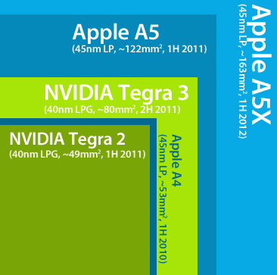
Apple iPad Statistics
 | Apple iPad 2 | Apple iPad (2012) | 11” Apple MBA
CPU | A5 @ 1GHz | A5X @ 1GHz | Sandy Bridge @ 1.8GHz
GPU | POWERVR SGX543MP2 @ 250MHz | POWERVR SGX543MP4 @ 250MHz | Sandy Bridge IGP @ 350MHz/1.2GHz
Memory Interface | 64-bit @ 800MHz = 6.4GB/s | 128-bit (for GPU) | 128-bit @ 1.3GHz = 20.8GB/s
Die Size | 122mm² | 163mm² | 149mm²
Battery Size | 25Wh | 42.5Wh | 35Wh
Data and Image from AnandTech

Slide 23
What will the future bring?
GPU Compute
PowerVR SGX Series5XT OpenCL capable, but no drivers
Could do compute the old-fashioned way with GLSL
Direct3D 11 means Compute Shader support
PowerVR Series6 press release suggests 100-1000 GFLOPS
Kepler-based GPU coming to a super phone near you?

